Slide 1


Biology in a Box
A science education outreach program brought to you by a partnership
between The University of Tennessee and the National Institute for Mathematical and Biological Synthesis
Visit us on the web at http://biologyinabox.utk.edu
Biology in a Box Team
Program Director/Author/Lead Editor: Dr. Susan E. Riechert (University of Tennessee)
Science Collaborators: Dr. Thomas C. Jones (East Tennessee State University), Dr. Stan Guffey (University of Tennessee)
Mathematics Collaborators/Editors: Dr. Suzanne Lenhart (NIMBioS), Kelly Sturner (NIMBioS), Lu Howard (University of Tennessee)
Outreach Coordinator: Dr. Lynn Champion (University of Tennessee)
Workshop Coordinators: Kathy DeWein (Austin Peay State University), Gale Stanley (Jacksboro Middle School)
Production/Assistant Editor: J.R. Jones (University of Tennessee)
Previous Contributors: Sarah Duncan, Communications (formerly with NIMBioS), Rachel Leander, Math Collaborator (formerly with NIMBioS)
This unit revised September 2012
Copyright 2012 by Biology in a Box, and the University of Tennessee. All materials in this unit and on the Biology in a Box web server (biologyinabox.utk.edu, eeb.bio.utk.edu/biologyinbox) may not be reproduced or stored in a retrieval system without prior written permission of the publisher, and in no case for profit.

Slide 2
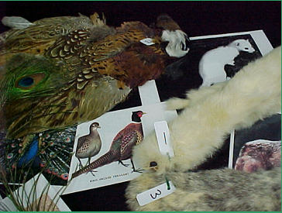
UNIT 3.
FUR, FEATHERS, & SCALES: INSULATION

Slide 3
Homepage Unit 3: Fur, Feathers, & Scales
Click on underlined text to go to information and exercises!
Materials List
Best not to let students see this until they have completed Exercise 1!
Introduction
Exercise 1. Animal Covering Match
Mathematics: Grouping like objects
Exercise 2. Insulation Power
Mathematics: Measuring length with a ruler, measuring temperature with a thermometer, ranking measurements, forming a hypothesis, recording and plotting data
Exercise 3. Keeping Warm
Mathematics: Converting between and K, variables, providing qualitative descriptions of relations described by linear equations, deriving formulas
Suggested Readings & Links
Clicking the icon on other slides will bring you back to this page!

Slide 4
Introduction
Animals and even plants generally need to keep their temperatures within a fairly narrow range in order to survive.
This is because chemical reactions that do work in living organisms function best within a narrow range.
Physical damage occurs if an individual becomes too hot or too cold.
Many organisms have mechanisms to cool themselves down or to warm themselves up, but these processes require energy and energy is expensive.
  It requires the procurement and processing of food.
Mammals and birds have developed body coverings that help protect them from gaining or losing too much heat.

Slide 5
Mammals release stored energy to produce and maintain constant internal body temperatures between 36 & 38°C (97 & 101°F).
  Fur, the thick coat of hair that covers the skin of a mammal, insulates (protects) internal organs from outside temperatures that might be higher or lower than the preferred temperature range.
Birds use energy to produce and maintain higher internal body temperatures between 40 & 42 ° C (104 &108 ° F).
  Feathers, light horny waterproof structures forming the external covering of birds, insulate birds against external temperatures that may be too warm or too cold.
Mammals & birds use energy to maintain a constant internal body temperature. Organisms that maintain body temperatures through internal metabolism (generating body heat through the chemical breakdown of food) are known as endotherms. The prefix “endo” means “inside”, and “therm” means “temperature”.

Slide 6
Reptiles do not release energy to maintain constant internal body temperatures. Instead, reptiles’ body temperatures depend on the temperatures of their environments. Organisms such as reptiles that must absorb heat from their surroundings to maintain body temperatures are known as ectotherms (the prefix “ecto” means “outside”).
  Thus, a reptile’s body temperature varies widely, and is strongly influenced by external factors such as air and substrate temperatures, sunlight level, and wind speed.
  Scales are stiff, flat plates that cover the reptile’s body. Scales DO NOT insulate the body against external temperature extremes. Rather, the scale body covering protects against water loss, or dehydration.

Slide 7
KERATIN
  The body coverings of mammals, birds, and reptiles are all made of the same material, keratin, a tough protein that does not dissolve in water (is insoluble)
  Keratin
  takes on different forms: fur, feathers, scales, horns, nails, and claws
  serves different functions: insulation, waterproofing, defense against predators.

Slide 8
The Students will…
Examine the different types of coverings reptiles, birds, and mammals have, and learn how some of these coverings insulate their owners from cold and hot temperature environments.

Slide 9
Materials List
Body Coverings
Alligator 8
Bear 6
Bird foot 12
Buffalo 4
Coyote 7
Deer 5
Goose 17
Kangaroo 16
Skunk 1
Pheasant 2
Rabbit 3
Rattlesnake 5
Mink 13
Mountain goat 18
Opossum 15
Parrot 9
Sheep 10
Turkey 11
Ice cube tray (prepare ice cubes in advance for Test 2C)
Pail
Stopwatch
timer
Dial thermometer
Sample mitts - plastic, aluminum, saw dust, cotton, wool, fur, bubble wrap
Sleeve samples - 3 fur, 1 blubber
Copper cylinder
Large and small zip lock bags

Slide 10
Exercise 1. Animal Covering Match
Mammals are covered with fur
Birds are covered with feathers
Reptiles are covered with rough or scaly skin without hair
All coverings are made from the same substance called keratin.

Slide 11
Objective
Exercise 1 Animal Covering Match introduces students to the variety of fur, feathers, and scales seen in the higher vertebrates: reptiles, birds, and mammals.
Students will get a chance to inspect the different types of body coverings, and attempt to match each sample with the animal from which it came.
Students will also be given information about the natural history of each of the animals represented in the box, with opportunities to think about and discuss how the various body coverings are adaptive to the organisms they represent.

Slide 12
For the exercise version:
for grades K-1
for grades 2+

Slide 13
Directions for Grades K-1
The teacher will mix the sample body coverings up and spread them out in front of the class.
One item at a time will be held up and the class will vote on which type of body covering it is: fur, feathers, or scales.
The sample will then be placed in the pile containing all samples of that type.
After all of the samples are sorted, the class should try to find the sample that matches each picture shown on the next three slides.
To Picture Slides

Slide 14
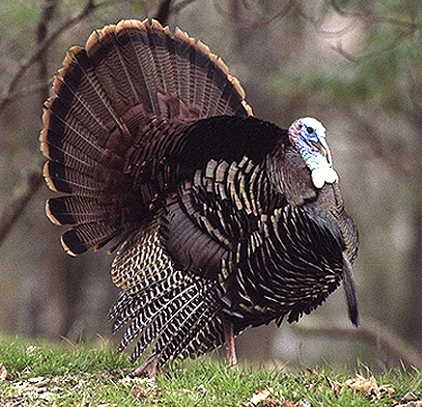
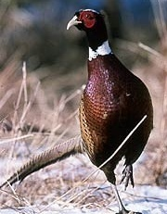
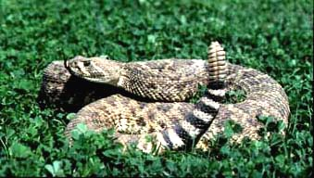
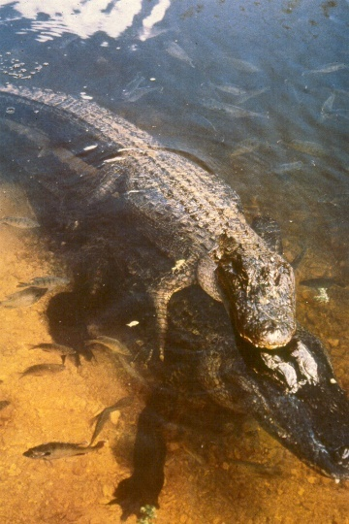
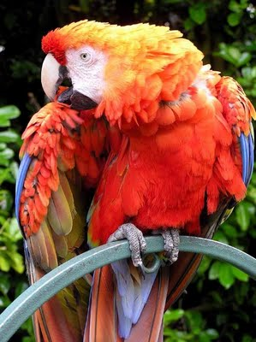
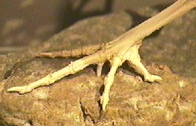
To next slide
Match the picture
to the covering
F
To Answer
Sheet

Slide 15
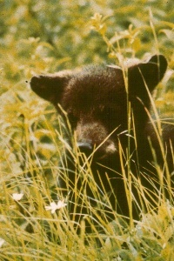
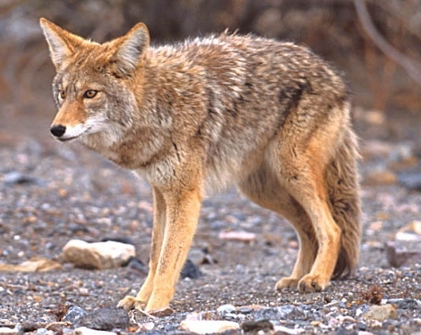
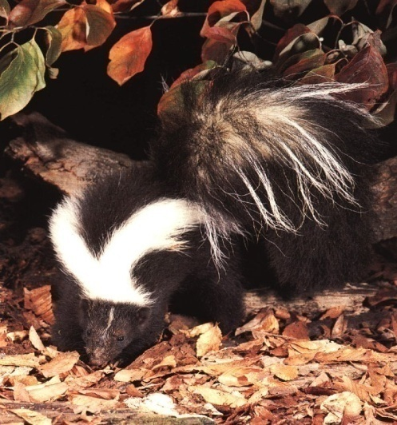
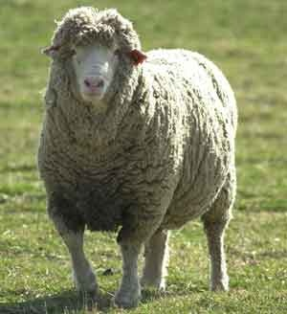
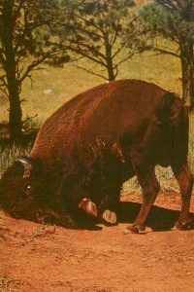
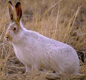
Match the picture
to the covering
To Answer
Sheet
To next
Image slide

Slide 16
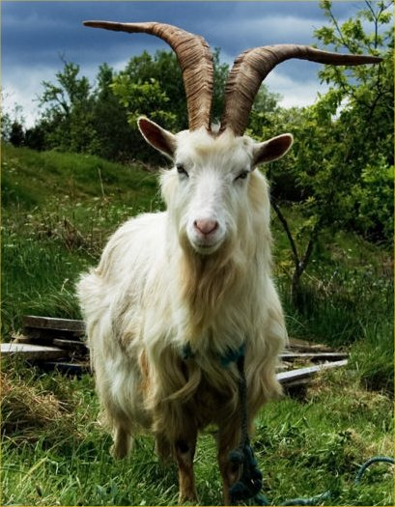
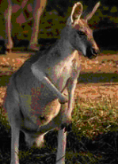
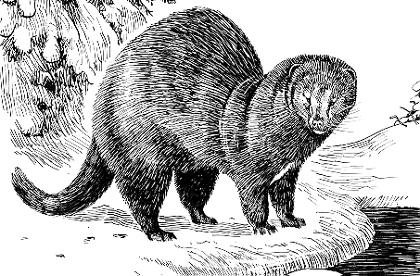
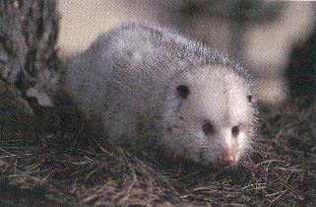
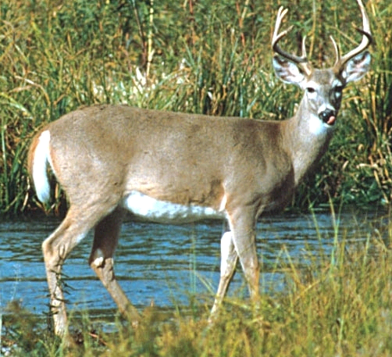
Match the picture
to the covering
Answer
Sheet

Slide 17
Directions
Form groups of 2-3 students
Each group will make a list of numbers on a sheet of paper from 1 - 18.
Your teacher will place the sample body coverings at stations around the room.
Each group should visit each station, examine the body covering sample there and
  1. Write under the number on your list that corresponds to that on the sample whether the covering belongs to a bird, mammal, or reptile

Slide 18
Directions continued
  2. Make a first guess as to what kind of bird, mammal or reptile is represented by the body covering sample & write the name down as well.
  Choose from this list:
Skunk
Pheasant
Rabbit
Buffalo
Rattlesnake
Bear
Coyote
Alligator
Parrot
Sheep
Turkey
Bird foot
Mink
Deer
Kangaroo
Opossum
Goose
Mountain goat
After visiting all of the stations, sit with your group.
The teacher will display 3 groupings of animals.
Match each picture (letter) with the correct sample number on your list.
For picture groupings

Slide 19


E
A
Match the picture
to the covering
F
B
F
D
G
C

Slide 20
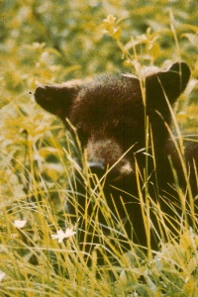

Match the picture
to the covering
H
J
L
I
K
M

Slide 21
N
Match the picture
to the covering
Q
P
R
O

Slide 22
Time to check your answers!

Slide 23
Answers: Numbers refer to tag # on samples
1. Mammal: Striped Skunk: J
2. Bird: Pheasant: E
3. Mammal: Rabbit: K
4. Mammal: Buffalo: I
5. Reptile:
Rattlesnake: F
6. Mammal: Black
Bear: H
7. Mammal: Coyote: L
8. Mammal: Alligator: B
9. Bird: Parrot: G
Mammal: Sheep: M
Bird: Turkey: A
Bird: Bird Foot: C
Mammal: Mink: P
Mammal: Deer: R
Mammal:
Opossum: O
16. Mammal:
Kangaroo: Q
17. Bird: Canada
Goose: D
18. Mammal: Mountain
Goat: N
To K-1 images

Slide 24

1. Mammal: Striped Skunk (J)
Mephitis mephitis
In the family Mephitidae, which contains 10 species of skunks in N. & S. America, and 2 species of stink badgers in Asia.
In the mammal order Carnivora, but have a very broad omnivorous diet.
The striped skunk is recognized by its characteristic colors and pattern of black and white stripes that start as a triangle on the head that splits into two stripes on the back before merging near the tail. Another stripe runs along the forehead to the base of the snout.
Skunk fur is not very dense or layered
  Skunks stay in burrows during the winter.
  Females often remain in their dens for the whole winter, while males usually emerge during mild temperature periods to feed.

Slide 25
2. Bird: Ring-necked Pheasant (E)
Phasianus colchicus
Ring-necked pheasants are native to Asia
  They were introduced into the US for hunting.
This bird has the body shape of a chicken, but has a striking long, pointed tail, which may extend 21 inches in males
Males are very colorful, with iridescent green-blue or purple heads and necks.
  Long, iridescent feathers along the sides of the head form a double crest. These “ear feathers” are raised when a male is courting a female.
  A white collar around the neck gives the species its name.

Slide 26
3. Mammal: Rabbit (K)
Sylvilagus sp.
Order Lagomorpha
Once included in the order Rodentia, but differ from rodents in that rabbits have two sets of upper incisors, rather than one.
  Rabbits also have a spongy bone lining their upper jaws that is believed to aid in releasing body heat when the animals are running.
Rabbits and hares are fast and evasive, and have large hind limbs suited for leaping great distances.
Rabbits also have large ears that alert them to the presence of predators.
The cottontail rabbit is active throughout the winter, and thus has a thick coat of fur.

Slide 27
4. Mammal: Buffalo/American Bison (I)
Bison bison
In the order Artiodactyla (even-toed mammals)
  Family Bovidae (which includes cattle, sheep, goats, & antelopes)
Bovids are among the world's largest land animals, and comprise much of the diets of many of the large carnivores of the world.
Bovids have permanent horns that continue to grow throughout the animal's lifetime.
  Horns are grown by all adult bovid males and by females of most genera.
  The horn is composed of a bony core that is covered with a hard sheath of keratin.
The buffalo’s shaggy coat of hairs is adapted to withstand cold winters and hot summers.
The shaggy coat is shed each spring and replaced with a shorter and lighter-colored summer coat of hairs.

Slide 28

5. Reptile: Rattlesnake (F)
Crotalus sp. or Sistrurus sp.
Rattlesnakes are ectotherms. Ectotherms often require long periods of basking in the sun to keep warm.
The viper family (Viperidae) contains over 220 species of venomous snakes, including more than 30 species of rattlesnakes.
The genus Crotalus are large snakes, & can reach over 2 m in length. The genus Sistrurus (3 species of pygmy rattlesnakes) only reaches around 80 cm in length.
The earliest North American snakes in this family evolved about 5 million years ago.
Most abundant in dry areas in the desert southwest US, though found throughout North and South America, from Canada to Argentina.
In winter, rattlesnakes congregate in dens (up to as many as 200 snakes!) to keep warm.
Covered with scales which help prevent desiccation (drying) and aid the animal in moving.

Slide 29
6. Mammal: Black Bear (H)
Ursus americanus
The 8 species of bears are in the family Ursidae.
Bears occur in a variety of habitats, from arctic ice floes to tropical rain forests.
All bear species except polar bears go through a period of deep sleep (hibernation) during the winter.
Though all bears are in the order Carnivora, nearly all bears are highly omnivorous (eat both plant & animal matter), with the exceptions of the almost exclusively carnivorous polar bear and the herbivorous panda.
Some black bears have brown or gray and black coats.
Bear fur is not as thick as the fur of mink and weasels that are active all winter.
Bears accumulate a lot of fat under their skin during the summer months, to help keep them warm during winter hibernation.

Slide 30
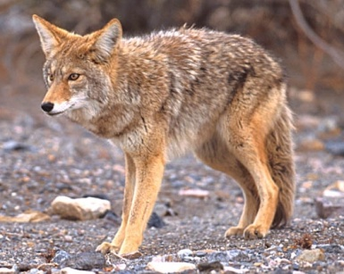
7. Mammal: Coyote (L)
Canis latrans
The family Canidae inhabits habitats from hot deserts to arctic ice fields
  In winter, they produce an undercoat of fluff and retain an outer coat of longer guard hairs.
  The fiberglass insulation in walls and ceilings is modeled after the excellent insulation properties of canid fluff fur.
Coyotes are the most widespread wild canid in North America. (Dogs are more abundant.)
Coyotes populations are highly adapted to local conditions.
  Desert coyotes are only half the size of their mountain counterparts, and their fur is much lighter in color.
  Coyotes at high elevations have fur that is thicker and longer than other coyote populations.

Slide 31

8. Reptile: American Alligator (B)
Alligator mississippiensis
The order Crocodilia contains 23 species of extant (currently living) crocodilians, but only eight species in the family Alligatoridae.
Males can reach 13-15 feet long, & up to 1000 pounds, but females are smaller (around 10 feet).
Bony plates (osteoderms) beneath the skin are great for protection, but don’t provide much insulation.
With large size & no fur or feathers to keep them warm, they live in warm climates. In winter, they hibernate in burrows they excavate with their snouts and tails.
Can survive freezing in water by keeping nostrils above the surface. If trapped below ice, they can survive for over 8 hours, because, being ectotherms, their metabolism is slowed by the icy water.

Slide 32

9. Bird: Parrot (G) &/or Peacock
Ara sp. &/or Pavo cristatus
The brightly colored feathers were collected from macaws, some of the most colorful parrots.
In their rainforest habitats, the bright coloration permits mates to find each other.
In addition, these highly social, flock-living birds are very vocal.
The long feathers are flight feathers, and the smaller feathers cover the body.
You might also have a section of the 3-foot long tail feather of a male peacock, an oriental bird that displays its fan of tail feathers when courting females.
Female peacocks select males that have the most striking displays as mates.
The huge, highly colored tail of the male, however, also attracts predators, which could cost the male injury and even death.

Slide 33
10. Mammal: Sheep (M)
Ovis aries
In the order Artiodactyla (even-toed ungulates).
The family Bovidae has 138 species of antelope, cattle, bison, buffalo, goats, and sheep.
Sheep (and many other even-toed ungulates) are called ruminants, & have a four-chambered stomach. After chewed plant matter is passed into the first chamber (the rumen), this partially digested “cud” is regurgitated to be chewed again.
  This sounds gross, but is an adaptation for processing tough plants that would otherwise be quite difficult to digest!
Long matted coats are adaptation to cold, wet climates.
A soft undercoat called fleece has been used to produce wool garments (that keep us warm when wet or dry, too!) for around 10,000 years!

Slide 34

11. Bird: Wild Turkey (A)
Meleagris gallopavo
Members of the order Galliformes, and are close relatives of the pheasants.
  Native to North America.
  Largest bird on the forest floor in the US, and has a lifespan of 10 years.
  Males can be distinguished by the fleshy wattle (‘snood’) that hangs down from its beak.
Though they are look clumsy, wild turkeys can fly at speeds in excess of 55 mph in short bursts!
Do not migrate for the winter, and rely on their thick coats of feathers, as well as a layer of fat, built up in the fall from eating acorns and hickory nuts, to keep warm.

Slide 35
12. Bird: Bird Foot (C)
Bird feet are not feathered, but rather covered with scales that are reptilian in nature.
Birds can shut off the blood flow to their legs during periods of cold temperatures.
  The scales do not provide insulation against temperature extremes.
  Thus, birds would lose too much heat through the exposed leg surface if blood were to flow there during cold periods.
The foot you have in your box belongs to a turkey, a goose, or a duck.
The turkey is the most terrestrial (lives on land) of the three species, and the duck is the most aquatic (lives on water). Can you determine which type you have?

Slide 36
13. Mammal: Mink (P)
Mustela vison
Members of the family Mustelidae, which includes the world's smallest carnivore – the American least weasel.
Weasels, ermine, minks, and otters are mainly found in cold environments and thus have soft thick fur.
The oily outer layer of fur repels water, because they live near rivers, streams, lakes, coastlines & marshes.
In the winter minks also grow long guard hairs that form a waterproof layer.
  This additional fur layer helps to keep them warm and dry when swimming in icy waters.
In the northern part of their range, the animals shed the brown fur, & replace it with a white coat in the winter.

Slide 37
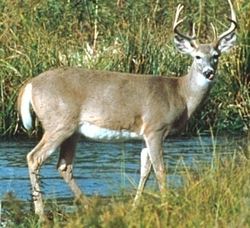
5. Mammal: Deer (R)
Odocoileus virginianus
45 species of deer in the family Cervidae, in the order Artiodactyla (even-toed ungulates).
Deer are slender-bodied, fast herbivores that browse on trees, and to a lesser extent, graze on grass.
Antlers are used by males in combat over females.
Red-brown summer fur changes to gray-brown in winter.
The throat and underparts of the deer’s fur are white, with white bands across the muzzle.
Fur of medium thickness; can do well in hot & cold environments.
White underside of tail is waved as a flag to help keep group members together and attract predators to the rear of the body, giving the deer a chance to escape.

Slide 38
15. Mammal: Opossum (O)
Didelphis virginiana
The opossum is North American’s only marsupial (immature young are raised in a pouch).
Opossums are nocturnal and scavenge both plant and animal matter (they are omnivores).
Opossums have a heavyset body that resembles a large house cat, but they have a pointed snout.
All opossums have long, tapered tails that lack fur.
Females have a fur-lined pouch to carry their young.
The color of the opossum varies by region.
  Northern populations have thick underfur that is white in color and has black tips. The pale guard hairs give the opossum a gray appearance.
Opossums are found in a variety of environments, ranging from relatively arid (dry) to mesic (moist) environments.

Slide 39
16. Mammal: Kangaroo (Q)
Macropus sp.
Kangaroo means “I don’t understand what you said” in the language of Australian Aborigines.
There are 47 species of kangaroo.
They are all herbivores (plant-eaters) in that they eat grass, leaves, and roots.
Close relatives of the opossum, as both are marsupials: the young are born at an early stage of development, and complete their development within a marsupial pouch on the mother’s body.
If you look at a opossum hair & a kangaroo hair, you will see they are very similar in structure.
  Native to Australia, New Guinea, & neighboring islands.
Though the countries in which they live do have snowy areas in the winter, roos tend to stay in the warmer, northern regions of these places, where the winters are relatively mild.

Slide 40
17. Bird: Canada Goose (D)
Branta canadensis
The Canada Goose is a common North American goose that can be seen on Tennessee waterways particularly in the fall and winter, as flocks move down from summer feeding grounds in the northern US.
  It makes a loud, honking sound.
This plant feeder has gray wing feathers and a lighter gray breast.
A predator would have difficulty seeing this bird as it rests on the water.
Note that the breast color of many mammals and aquatic birds is white or not strongly colored.
  It costs energy to produce the pigments that give keratin color.
  The surface of the animal that is not exposed to predators typically lacks pigmentation (color is not selected for).

Slide 41

18. Mammal: Goat (N)
Capra hircus
Family Bovidae; order Artiodactyla (even-toed ungulates) .
Artiodactyls are called cloven-hooved, because there are two main toes on each foot.
The genus Capra contains 9 species of ibexes & goats, including domestic goats (with over 210 different breeds!).
Found in many climates from deserts to mountainous regions.
Domestic goats are bred for several purposes: dairy use, fiber (fur), goatskin, meat, or as companions.
Based on your sample, from what climate do you think that particular goat came, or for what purpose was it bred?
Goats also get gray/white hair as they age, just as in humans. Why does hair turn gray as an individual ages?

Slide 42
Exercise 2. Insulation Power
Fur, feathers, and scales are all made of the same material, keratin.
Keratin scales in reptiles and bird legs provide no insulating properties.
Fur and feathers help maintain body temperature by trapping still air, which is called insulating power.
Two factors determine the amount of air that is trapped in fur and feathers:
  the density of the individual hairs or feathers
    (e.g., numbers of hairs/unit of surface area).
  the thickness of the layer
  A thick, dense layer of fur can trap more still air than a thin layer of fur with sparse hairs.

Slide 43
Objective
Exercise 2. Insulation Power, provides qualitative and quantitative exploration into the insulation properties of body coverings.
The following tests achieve this objective:
Exercise 2A: Fur density and thickness
Exercise 2B: Feel Test
Exercise 2C: Melt Test
Exercise 2D: Insulating Mechanisms
Exercises 2B, C, & D increase in level of quantification (numerical expression of levels of insulation offered)

Slide 44
Exercise 2A: Fur density and thickness
Place students in groups of 2 or 3, and assign each group a piece of fur.
Students should observe the smaller samples of fur, each of which has been obtained from the same surface area (19.63 mm²), in the small sealed Petri dishes.
Since counting individual hairs would be difficult, even for such a small area of fur, each group should visually rank each fur sample in order from most dense to least dense, assigning a rank of 1 to the most dense fur, and a rank of n (where n is the total number of fur samples) to the least dense. It may be helpful to do this via comparing only two samples at a time, deciding which fur is denser, then repeating the procedure until all fur samples are ranked in terms of density.

Slide 45
Exercise 2A: Fur density and thickness
It may also be helpful to place fur samples on a light or dark background for contrast, in order to be able to better see the individual hairs.
Take care to note density in terms of number of hairs, and attempt to avoid being influenced by differences in lengths of the individual hairs.
Each student in a group should then take a measurement of fur depth using the following procedure:
  First place the fur sample on a flat surface.
  Using a centimeter ruler, measure the depth of fluff fur when the hair is brushed erect.
  The long guard hairs are used in keeping water out, & should not be counted as part of the fur’s insulation value.
  For guidance in using a centimeter ruler for younger students, click HERE. Otherwise, click HERE to move on.

Slide 46
Using a centimeter ruler
Place your ruler in front of you. It will look similar to the picture of the ruler below.
If your ruler has inches on one side and centimeters on the other side, be sure you are using the centimeter side of your ruler.
The numbering on your ruler indicates lengths in centimeters, and most classroom rulers show numbering from 0 to 30, meaning you can use the ruler to measure a length up to 30 cm.
Look closely at the numbering and the marks on the centimeter (cm) side of your ruler.
Go on to the next slide for further information.

Slide 47
Using a centimeter ruler
Lines are marked on the ruler to help you determine your measurement and you can see those lines are evenly spaced along the ruler.
You will also see that those lines are of different lengths. The longest lines closest to the numbering indicate centimeters, but you will also see lines of shorter lengths between those longer lines.
The lines that are only slightly shorter than the centimeter lines indicate the halfway point between centimeters, and the shortest lines indicate millimeters (mm). You can see that the millimeter lines are very close together! The ruler you are using does not have millimeters numbered because the spaces are too small to write the numbering. The numbers you see on the ruler indicate centimeters.
There are 10 millimeters in every centimeter.
Go on to the next slide for more information!

Slide 48
Using a centimeter ruler
Look at the section of your ruler between the numbers 1 and 2.
Beginning at the longer line at the number 1, count the number of those very small spaces indicated by the individual lines between number 1 and number 2.
Each of the tiny spaces you counted has a length of one millimeter. Did you count 10 spaces? There are 10 spaces because the metric system is based on sets of 10. If you count the tiny spaces between any two numbers that are next to each other, you will count 10 tiny spaces.

Slide 49
Using a centimeter ruler
Practice measuring things on your desk using the centimeter ruler. Work with a partner and measure a textbook, a pencil, and a piece of paper, for example.
Compare your measurements with your partner and see if you have the same measurements.
Remember, there are 10 millimeters in every centimeter, and the numbers on the ruler indicate centimeters. If something measures at the “2” centimeter mark on the ruler, that means it measures 20 millimeters, because there are 10 millimeters in every centimeter!

Slide 50
Each group member has taken a measurement for fur thickness, so you should now have 2-3 values. Now average your values to present the mean to the class.
Compute the mean value (average) from the 2-3 measurements you made of fur thickness. The mean value refers to central tendency. The formula for calculating the mean for fur depth is:
Mean Fur_{d} = Sum X/n
  Sum = total of the two or three measurement made
  X = each of the two or three measurments X₁, X₂, X₃
  n = total number of measurements (2-3 in this case).
Example: If the three measurements of fur thickness were 10 mm, 11 mm and 9.5 mm, Mean Fur_{d} = (10 + 11 + 9.5)/3, or Mean Fur_{d} = 10.16 mm which can be rounded off to one significant digit or 10.2 mm

Slide 51
The teacher will make a list of the fur samples used from 1….n on the board. See template on upcoming slide
Each group will report their ranks for each type of fur. Teachers may wish to use each group’s density rankings to calculate average density rankings for each fur type, which should reduce the effects of any bias from a single group.
Each group should also report their thickness estimate for the fur type they were assigned.

Slide 52
Calculate the sum ranks for each fur type. This is accomplished by adding the rank for fur density to the rank for fur thickness for each mammal species.T
These rank sums can be used to assign overall ranks to each fur type with regards to total insulation power.
To fill in the “Overall Rank” column, you should simply assign ranks based on the “Sum Ranks” column, assigning a rank of 1 (representing the best insulation power) to the species with the lowest sum rank, a rank of 2 to the species with the next lowest sum rank, and so on, until all fur samples have been given overall ranks ranging from 1 to n (where n is the total number of fur samples).

Slide 53
Thickness and density table format
Fur Type | Density Rank (DR) | Thickness (mm) | Thickness Rank (TR) | Sum Rank DR + TR | Overall Rank
Where 1 = best insulation characteristics

Slide 54
Question: One might expect that individuals living in the coldest environments will have the thickest fur, and thus the greatest ability to trap still air. What would be a reason for this not being the case?
Stop!!! The Answer is Next!
Answer: Many animals that live in cold environments
shed their warm fur coats during the summer months, when
not as much insulation is needed. Some of the fur samples may have been collected from animals possessing their
summer coats. Also, the thickness and density of an animal’s fur may vary on different parts of its body, as different body regions may require more or less insulation. Fur samples may have been collected from different areas of the animals’ bodies.
On to further measures of insulation value

Slide 55
The following three experiments (2B. Feel Test, 2C. Melt Test, and 2D. Insulating Mechanisms) will help you to further understand the phenomenon of insulation power.
Materials needed for experiments 2B and 2C.
  Ice cubes
  Hot tap water
  Pail
  Stopwatch
  Small and large zip lock bags
  Container A
  Control mitt (double plastic bag)
  Treatment mitts (materials trapped between two plastic bags):
    cotton, bubble wrap, wool, sawdust, aluminum foil, rabbit fur
To Exercise 2B Feel Test

Slide 56
2B. Feel Test.
This is a qualitative test that relies on an individual’s judgment and memory using the sense of feel.
The teacher will place the mitts filled with different materials across a desk in the front of the room:
  cotton, bubble wrap, wool, sawdust, aluminum foil, rabbit fur
The teacher will identify each of these materials to the class
Fill the pail with ice and add water.
Select one volunteer at a time to perform the test on a pair of mitts. The student will insert his or her hand into one mitt and extend the mitt into a large zip lock plastic bag before inserting it into the bucket far enough to be in the ice but not allowing the water to flow in the top. Wait 15 seconds, and remove the mitt. Put on the second mitt and repeat. The student will tell which mitt kept his or her hand warmer, or if they were the same.

Slide 57
This result should be recorded on the board and the process repeated with a new volunteer and different combination of mitts until all of the possible combinations have been tried.
From these results make a ranking of your materials from best insulator to worst insulator.
Discuss & save results for comparison to Test 2C

Slide 58
2C. Melt Test
This test provides a more accurate estimate of the relative insulation power of the various materials available than does the feel test.
**The night before, fill the ice cube tray to the black dot mark representing 1 cm depth.
Student volunteers will place one ice cube (1 cm thick) in each of 6 small zip lock bags.
A well sealed-bag containing an ice cube should then be placed in each of the material mitts: cotton, bubble wrap, wool, sawdust, aluminum foil, rabbit fur
Care should be taken to get most of the air out of each bag with the ice cubes!!!

Slide 59
The mitts will be placed on a table at the front of the room and checked every 10 minutes to determine how many minutes elapse before the entire ice cube has melted and only water remains.*
  Use the timer to alert students at 10 min intervals, so that checks can be made while they are completing other work.
  On a sheet of paper in front of each mitt, make a check for each interval, so that these can be tallied at the end to obtain time elapsed to total melt.
* Less time-consuming options include:
1. Time lapsed to first sign of melting
2. Time lapsed until some fraction remains (e.g., 1/2)

Slide 60
Rank your materials from longest to shortest melt time in the first column of the three column table shown below.
Assign the rank of 1 to your best insulating material and so on to 6 for the least best insulating material in column 2.
Material | Melt test rank | Feel test rank
Fill in the ranks of materials from the results of the Feel Test
under Exercise 2B in column 3.
Answer the questions about your insulation tests 2B and 2C on the next page.

Slide 61
Q1: How did your ranks compare between the Feel (Exercise 2B) and Melt tests (Exercise 2C)? If they differed, which would be the more accurate ranking of materials and why?
Stop!!! The Answer is Next!
A1: The ranking based on the degree of ice cube melt would be the least subjective or most objective (least influenced by human perceptional bias and memory). Thus the ice melt test would provide the more accurate ranking of material insulation powers.
Supersolver question Q2: What is it about the different materials that made them better or worse insulators?
Stop!!! The Answer is Next!
A2: The best insulators should provide for the most room for still air between the material surface and the skin of the animal (in this case simulated by the surface of the ice cube).

Slide 62
Q3: What is a potential problem with the Melt Test experiment?
Stop!!! The Answer is Next!
A3: The materials were not all equally thick or dense. It was, for instance, easier to pack in more sawdust in the space provided than wool.

Slide 63
Exercise 2D. Insulating Mechanisms
Materials
ice water
water at room temperature
Pail
Stopwatch from Container A
Materials in Container B
Copper cylinder
Metal disk thermometer
Zip lock bags
Body covering sample sleeves (3)
Fat (blubber) sample sleeve

Slide 64
Pass the fur samples around the class and have the students run their hands against the fur on the skins. Notice how the fur stands up.
Mammals and birds react to unfavorable temperatures by erecting (raising) their fur or feathers.
Find the 3 fur samples in Container B:
1. Plastic container of loosely packed fur that corresponds to erect fur on a mammal
2. Plastic container of fur that is more tightly compressed, corresponding to non erect fur
3. Plastic container of oiled fur, as would happen in an oil spill.
Fill the pail with ice water
  Fill the copper cylinder with water at human body temperature (98-99°F; use dial thermometer)
  Select one of the samples for testing

Slide 65
For each run with a different covering:
  Insert the dial thermometer in the top of the tube, and measure and record the temperature of this water.
  Slip one of the three fur samples onto the bottom of the tube and slide this unit into a large zip lock bag.
  Insert the assembled unit in ice water, and measure water temperature within the cylinder at 0 min, 5 min, 10 min, and 15 min, etc.
  Be sure to label the data you have collected as to sample type.
Repeat this procedure for each of the covering samples, being sure to:
  Replace the water in the copper tube
  Replace the ice water when necessary.

Slide 66
Plot curves of your results for the three fur samples. The table below and figure on the next slide provides an example of how to summarize your data from this experiment:
Example of data collected for three fur treatments (water in cylinder started at room temperature in this example)
Temperature
Time (mins) | Fluffed | compressed | oiled
0 | 70 | 70 | 69
5 | 70 | 68 | 67
10 | 69 | 55 | 53
15 | 67 | 50 | 48
Continued on next slide

Slide 67
Fig. 1b. Example plot, based on data from table on previous page

Slide 68
Answer the following two questions.
Q1: Which sample provided the best insulation?
Stop!!! The Answer is Next!
A1: Fluffed fur provides the best insulation
Q2: Why were the temperature curves for oiled and compressed fur similar?
Stop!!! The Answer is Next!
A2: Compressed fur and oiled fur have similar insulation properties, because in oiling fur we are compressing it, which makes it hold less still air.
Now examine some of your furs again. Note that some samples have two types of fur present: 1) longer outer guard hairs and underlying fluff. The guard hairs protect the underlying fluff from getting wet, but it is the fluff fur that provides the insulating power.

Slide 69
Q3: Why are oil spills so dangerous to mammals and birds that are exposed to the oil?
Stop!!! The Answer is Next!
A3: Oil compresses fur so that it loses its insulation power. As a result, oiled animals have difficulty maintaining body temperature.
Q4: Why do humans get ‘goose bumps’ when we feel cold?
Stop!!! The Answer is Next!
A4: Humans have the same hair-erecting mechanism that is characteristic of mammals that have fur (fur is merely hair that is more dense than that of humans).

Slide 70
Examine a feather, noting that part of the feather is equivalent to fluff fur. In addition to providing lift for flight, the long part of the feather guards the down (fluff) at the base from getting wet. In some water birds, the feathers even hook together to provide greater protection against water getting through.
Establish a temperature curve for the blubber sample just as you did for the three fur samples.
Blubber too has good insulating power, and mammals that live in the water, particularly in cold regions, utilize blubber (a fat layer just under the skin) for insulation.

Slide 71
Answer the following questions:
Q1: Why do mammals in cold waters utilize a blubber layer for insulation?
Stop!!! The Answer is Next!
A1: The fur of many aquatic mammals does not provide
good insulating power, as it is wet much of the time.
Q2: If blubber is such a great insulation, why do not all mammals use it?
Stop!!! The Answer is Next!

Slide 72
A2: Blubber or fat is problematic for two reasons.
1. Unlike fur, it cannot be shed during the summer when temperatures are warmer.
2. A fat layer is not dependable, as it is metabolized (broken down) when the body needs energy to do work.
Q3: Where else in our lives do we see insulation?
The answer is on the next slide!!!

Slide 73
A3: We insulate the floors, walls, and ceilings in our homes. Our jackets, gloves, earmuffs, hats, and boots often have insulation. Sleeping bags and quilts have insulation. Stoves and refrigerators have insulation, as well. Coolers, too. There is a wall of insulation between the engine of a car and the passenger compartment. Remember, insulation can protect from both heat and cold, and in the case of human use, even sound.

Slide 74
Exercise 3. Keeping Warm
Objective: Under Exercise 2 Insulation Power, students investigated how feathers, fur, and even blubber help animals to maintain a constant body temperature. In this exercise, they will explore the phenomenon of temperature.
Click a link below to go to a section of this exercise.
Introduction
Exercise 3a. Conductivity vs Insulation
Exercise 3b. R-values

Slide 75
Introduction
Temperature:
If you place your hand against your forehead, it feels warm. If you place your hand on your desktop, it feels cool. We can express this fact by saying that the ‘temperature’ of your skin is greater than the temperature of your desk. We can even confirm this fact by measuring the temperature of these two objects with a thermometer. But what is temperature exactly?

Slide 76
What is Temperature?
The temperature of an object is a measure of how fast the molecules within the object are randomly moving about and bumping into one another. The surface of your desk may appear to be still, but in fact, the individual molecules that make up its surface are always in motion. The faster an object’s molecules move on average, the greater the object’s temperature.

Slide 77

Temperature in scientific studies is measured in degrees Kelvin (K) or the closely related degrees Celsius (°C). In the United States, we also express temperature in degrees Fahrenheit (°F).
The quantitative relationships among these temperature measures are as follows (write these down to use later!):
Zero Kelvin (0 K) is the temperature at which all molecular movement stops, and is known as absolute zero.

Slide 78
Converting Temperatures
Using the equations from the previous slide, answer the following questions:
Q1. Which temperature is warmer, 0°C or 20°F?
Q2. If x is a real number, then x°F > x°C . Explain why.
Q3. Find the formula to convert °C to °F.
Q4. Convert 18°C to K.
Answers are on the next slide!

Slide 79
Temperature Conversion Answers
Q1. Which temperature is warmer, 0°C or 20°F?
0°C is warmer. Since °F =(9/5)°C+32, 0°C = 32°F!
Q2. If x is a real number, then x°F > x°C . Explain why.
x°F = (9/5)x°C + 32 > x°C
Q3. Find the formula to convert °F to °C.
°C = (5/9)(°F – 32)
Q4. Convert 18°C to K.
18°C + 273.15 = 291.15K

Slide 80
Thermal Conductivity
The last quantity we will consider is thermal conductivity, a measure of how easily heat flows through a material. Heat flows very easily through some materials, such as metals and rocks, while other materials such as air, allow very little heat to flow through them. We can express this fact by saying that metals have greater thermal conductivity than air.
The thermal conductivity of an object is usually denoted by k. Thermal conductivity is measured in Watts per meter Kelvin (W/mK), where
1 Watt = 1 joule per second, or expressed symbolically
  1W = 1J/sec

Slide 81
If your text book feels cool to the touch, then you know that its temperature is lower than that of your hand.
Your fingertips, however, are not sensitive enough to determine the average speed at which the text book’s molecules move (i.e. the temperature of the text book). Instead, your fingertips sense the rate at which heat energy flows out of your body and into the book. (Recall that heat flows from higher temperatures to lower temperatures.)
This means that an object with very low thermal conductivity could be very hot, perhaps thousands of degrees Celsius, and yet feel comfortable to touch.
For example, the conductivity of the high-temperature reusable surface tile used to protect the orbiter space shuttle is so low that you can comfortably hold a tile in your hand only seconds after it is removed from a 2,300°F oven, while it continues to glow red.
Continue on to Exercise 3a

Slide 82
Exercise 3a. Relationship between Temperature, Conductivity, & Insulation
Examine the table below, which displays the conductivities of several materials in W/mK. You may wish to write these down to answer questions regarding these materials!
Material | Conductivity (W/mK)
Water | 0.600
Soil | 1.500
Rock | 4.000
Air | 0.025
Blubber | 0.140
Deer:1 hair | 0.260
Deer fur | 0.091
Copper | 401.000

Slide 83
Directions
Find the bag labeled Exercise 3 in the trunk. All of the items in the trunk will be at the same temperature. Place your hand on each item to see how cool it feels, and then use this observation to rank the items from most thermally conductive to least thermally conductive.
Find additional items in your room that have been allowed to equilibrate to room temperature (e.g., a glass of water, a book).
Use the table provided and Google to check your rankings. You might wish to retest those materials that you first misplaced.

Slide 84
Exercise 3a: Questions
Q5. Which material listed in the table is most conductive, and which is the least conductive?
Q6. Which material is the best insulator? Which material is the worst insulator?
Q7. What is the relationship between a material’s thermal conductivity and its ability to insulate?
Q8. Why do snakes move out onto paved roads and lie on them at night?
More questions and answers are on the following slides!

Slide 85
Exercise 3a: Questions (cont.)
Q9. Which cools you down more on a hot sunny day: sitting in front of a fan or taking a dip in a swimming pool? Why?
Q10. Why does deer fur have such low conductivity, when compared to a single deer hair?
Q11. Since reptile scales are made of the same material as fur, why is fur a good insulator, while reptile scales are a poor insulator?
Answers are on the following slides!

Slide 86
Exercise 3a Answers
Q5. Which material listed in the table is most conductive, and which is the least conductive?
Copper is most conductive, & air is the least conductive.
Q6. Which material is the best insulator? Which material is the worst insulator?
Copper is the worst insulator, and air is the best insulator.
Q7. What is the relationship between a material’s thermal conductivity and its ability to insulate?
They are the inverse of one another: a good insulator is a poor conductor of heat, and vice versa.

Slide 87
Q8. Why do snakes move out onto paved roads and lie on them at night?
Reptiles are ectothermic, in that they regulate their body temperatures largely by exchanging heat with their surroundings: ‘Ecto’ means ‘outside’. Rocks and roads made of rock material have high conductivities. Exposed to the sun during the day, a paved road takes up heat, and at night will give up this heat to snakes lying on it. This allows snakes to be active longer at night in search of mice and other rodents that are nocturnal (night active). This behavior pattern is a boon to herpetologists who can drive the roads at night to pick up specimens for their research.

Slide 88
Q9. Which cools you down more on a hot sunny day: sitting in front of a fan or taking a dip in a swimming pool? Why?
A dip in a pool, definitely. This is because the thermal conductivity of water is 24 times better than that of air. It can more quickly absorb our body heat.
Q11. Since reptile scales are made of the same material as fur, why is fur a good insulator, while reptile scales are a poor insulator?
Keratin itself is a good heat conductor, and thus a poor insulator. The keratinous scales of reptiles are flat and fit tightly to the body to prevent desiccation or water loss. They are not designed to trap air, which gives coverings of fur and feathers their great insulation properties.

Slide 89
Q10. Why does deer fur have such low conductivity, when compared to a single deer hair?
Fur and feathers are both good insulators, that is, they have low conductivities. So, it may surprise you to learn that both fur and feathers are made up of thousands of hairs or fibers, each of which is not a good insulator. These individual hairs are poor insulators because they are made of a material called keratin, which has a relatively high conductivity. Fur is a much better insulator than the individual hairs that it is made of because fur traps large amounts of air, which is a great insulator. In fact, the conductivity of air is only about 0.025 W/mK, making it one of the best insulators available. (Continued on next slide)

Slide 90
The amount of air trapped by a cubic centimeter of fur depends on the fur’s density, that is, the number of hairs per unit area. Animals that live in cold climates typically have much denser fur than animals that live in warm climates. For example, rabbit fur density is estimated to range from 4,100 hairs per cm² to 11,000 hairs per cm², while the fur density of most primates is below 1,000 hairs per cm². In summary, dense fur traps more air, and thus has lower conductivity (and higher insulation power) than sparse fur. The conductivities of several types of fur are listed in the table below.
Animal | Fur Conductivity (W/mK)
Wolf | 0.05443
Arctic Wolf | 0.04591
Grizzly Bear | 0.06059
Polar Bear | 0.04396
Rabbit | 0.04012

Slide 91
Q11. Since reptile scales are made of the same material as fur, why is fur a good insulator, while reptile scales are a poor insulator?
Keratin itself is a good heat conductor, and thus a poor insulator. The keratinous scales of reptiles are flat and fit tightly to the body to prevent desiccation or water loss. They are not designed to trap air, which gives coverings of fur and feathers their great insulation properties.
Continue to Exercise 3b

Slide 92
Exercise 3b: R-values
R-values are used in home and industrial insulation applications. They are based on material conductivity and the laws that govern heat exchange. Animal body coverings follow the same rules.
As individuals or teams, research the topic of insulation as it relates to R-values outside of class and learn how they are calculated.
Apply your knowledge to answering the following questions.

Slide 93
Exercise 3b Questions
Q12. If the temperature outside a home is less than the temperature inside a home, will heat flow into the home or out of the home?
Q13. How does the rate at which heat flows through the wall change as the thickness of the wall increases?
Q14. If you were to compare the fur of a snowshoe hare in winter to that of a snowshoe hare in the summer, how would you expect these two coats to differ? Which coat would be the thickest? Which coat would be the densest?
More questions and answers are on the following slides!

Slide 94
Exercise 3b Questions (cont.)
Q15. If the outside temperature is -5°C, and the internal temperature of a hare is 99°F, does heat flow into or out of the hare’s body? What if the hare is in the desert and the outside temperature is 40°C? (Be careful with your units!)
Q16. What is the heat loss through a 1m square window on a home, if the outside air temperature is 15 °C, the inside temperature is 25°C, and the R-value of the window is 2 Km²/W? (Be careful with your units!)
Answers are on the following slides!

Slide 95
Exercise 3b Answers
Q12. If the temperature outside a home is less than the temperature inside a home, which way will heat flow through a window or wall ?
Heat flows from the inside to the outside.
Q13. How does the rate at which heat flows through a wall change as the thickness of the material gets larger?
As the thickness of a material gets larger, the rate at which heat flows through the wall of this material gets smaller.

Slide 96
Q14. If you were to compare the fur of a snowshoe hare in winter to that of a snowshoe hare in the summer, how would you expect these two coats to differ? Which coat would be the thickest? Which coat would be the densest?
We would expect the snowshoe hare to shed hair in the summer so that its coat would be less dense in the summer months than in the winter months. We wouldn’t expect the thickness of the fur to change, as fur thickness is determined by the length of the individual hairs.

Slide 97
Q15. If the outside temperature is -5°C, and the internal temperature of a hare is 99°F, does heat flow into or out of the hare’s body? What if the hare is in the desert and the outside temperature is 40°C?
In order to compare the hare’s temperature to the outside temperature, we must first convert it to degrees Celsius. Using the formula above we find that
(5/9)(99°F – 32) = 37.2°C
Then, since heat flows from warmer regions to cooler regions, we see that in both cases, heat flows out of the hare’s body.

Slide 98

Q16. What is the heat loss through a 1m square window on a home, if the outside air temperature is 15°C, the inside temperature is 25°C, and the R-value of the window is 2 Km²/W? (Be careful with your units!)
To find the heat loss per square meter, simply divide the temperature difference by the R value. Since there is a difference in temperature of 10°C (which also is equal to 10K), and the R-value of the window is 2 Km²/W, energy will be lost at a rate of
through the window. Since the area of the window is equal to 1 ^{m2}, heat is lost through the window at a rate of 5 Watts, or 5 joules per second.

Slide 99
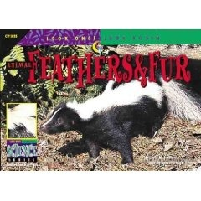
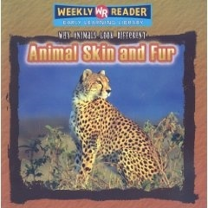
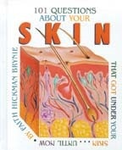
Suggested Reading
Grades K-3
Fur and Feathers - Elizabeth Miles
Feather and Fur! What Makes Cats Purr?: Exploring Your Pet's World - Boughton Cobb
Animal Feathers & Fur - David M. Schwartz and Dwight Kuhn (Illustrator)
Feathers and Hair - Ted O'Hare
All About Heat - Lisa Trumbauer
The Magic School Bus in the Arctic: A Book About Heat - Joanna Cole, Art Ruiz (Illustrator), Bruce Degan (Illustrator)
Grades 4-7
Animal Skin and Fur - Jonatha A. Brown, Susan Nations, Debra Voege
Why Mammals Have Fur - Dorothy Hinshaw Patent
Adaptation - Alvin Silverstein, Virginia B. Silverstein, Laura Silverstein
Energy - Chris Woodford
Energy - Alvin Silverstein, Virginia B. Silverstein, Laura Silverstein
Grades 7+
101 Questions About Skin That Got Under Your Skin...Until Now - Faith Hickman Brynie
Energy Projects for Young Scientists - Richard Craig Adams, Robert Gardner

Slide 100
Scientific Journal Articles
(PDFs included on Teacher CD!)
Blouin-Demers, G. and P.J. Weatherhead. 2001. An experimental test of the link between foraging, habitat selection, and thermoregulation in black rat snakes (Elaphe obsoleta obsoleta). Journal of Animal Ecology 70(6):1006-1013.
Kenagy, G.J. and O.P. Pearson. 2000. Life with fur and without: experimental field energetics and survival of naked meadow voles. Oecologia 122:220-224.
M.E. Watanabe. 2005. Generating heat: New twists in the evolution of endothermy. Bioscience 55(6):470-475.

Slide 101
Links (all underlined text is clickable!)
Chem4Kids.com: Reactions: Thermodynamics
Physics4Kids.com: Thermodynamics & Heat
Biology4Kids.com: Animal Systems: Integumentary System
Biology4Kids.com: Vertebrates
Kids’ Health: Skin, Hair, and Nails
Slowing the Flow
“Slowing the Flow” is part of the OLogy website for kids from the American Museum of Natural History, and gives kids a great experiment demonstrating the mammalian diving reflex (MDR)
Rubber Blubber Gloves
(“Rubber Blubber Gloves” is another OLogy experiment demonstrating animal insulation from AMNH)
Infrared Zoo Gallery
This is a really cool site that shows infrared thermographs of a wide variety of animals, as well as discusses insulation!
Fossil hints at fuzzy dinosaurs (BBC News)
Temperature & Humidity in Nature
ColoradoENERGY.org - R-Value Table

